Slide 1
Project 3: Group 3 Business Ideas
Group 3 Members:
Jiang Guanlin, Huang Tianji, Hong Yuling, Lau Choi Yu, Lam Wan Yuet, Yang Xiao Lin, Lam Ho Yan

Slide 2
Time Memories Imager (Demo Link (OneDrive))
Use time and location to record your memories
Display them to you when you want to recall the past
Notes:
David

Slide 3
Customer
Target Group:
The whole group who likes to take pictures/share their own pictures
Problems:
Forget where and when the pictures were taken
Hardly shared with others along with pictures’ location
Needs:
Remember where and when each photo was taken in a convenient way
Share the picture and its location with others along at the same time
Notes:
Christy

Slide 4
Concept – Why?
- A sense of nostalgia
- Only short memories are stored in the brain
- People cannot remember too many things
e.g. people, event, time, place etc.
Notes:
Aileen

Slide 5
Concept – What?
An app to record memories at that moment, that place and share with others
Notes:
Aileen

Slide 6
Concept – How?
Camera: capture pictures
e.g. scenery, items, people …
Detail: record location and time which the photo was taken
Edit: draw (pattern), write (note)…
Gallery: collection of memories in a certain time
Share: people, social media ...
--> recommendation
Notes:
Elise

Slide 7
Concept – Creative Formula
Camera ✖️ Gallery ✖️ Internet
Notes:
Elise

Slide 8
Company - People
Nirvana Rebirth is a professional team which made up of different experts
Graphical designer
Testing personnel enginneer
Advertising expert
Computer engineer
Notes:
Gigi

Slide 9

Company - Product
Core Product
Location and time storing system
Local database to store photos
Photos editing functions
Share function
Actual Product
Details of photos appear on the user interface
Gallery display the photos in order
Drawing and adding text functions
Notes:
Leavia

Slide 10
Company - Profit
Free for basic functions
Charged for advanced functions
No advertisements for premium
Pay for limited-time special designed decorations
The fee based on times can attract the potential customers to purchase the monthly plan
Basic Function | Make the Photo Timeline and video | Cloud Storage (Compress) + Timeline Video | Cloud Storage (Original image) + Timeline Video
Free | 10 HKD / time | 20 HKD / Month | 40 HKD / Month
AD | No AD | No AD | No AD
Notes:
David

Slide 11
Company - Place
Available to download for free from
APPLE APP Store
GOOGLE Play Store
Our website (apply for both Android and IOS)
Some Mainland China Platform (only Chinese Version)
Notes:
Oliver

Slide 12
Company - Promotion
Macro-influencers
Micro-influencers
Advertisements in different social media
Trial period for promotion
Notes:
Gigi

Slide 13
Company - Partnership
Cooperate with…
Local artists
limited-time special designed decorations
Animation production companies
Offline activities
E.g. download our APP for free check-in with animation characters
Notes:
Leavia

Slide 14
Competitor Analysis
A+ Gallery
Similar functions : location, photo sharing
Extra functions : photo hiding with password
Disadvantage : requires users to pay in order to use some functions
Notes:
Oliver

Slide 15
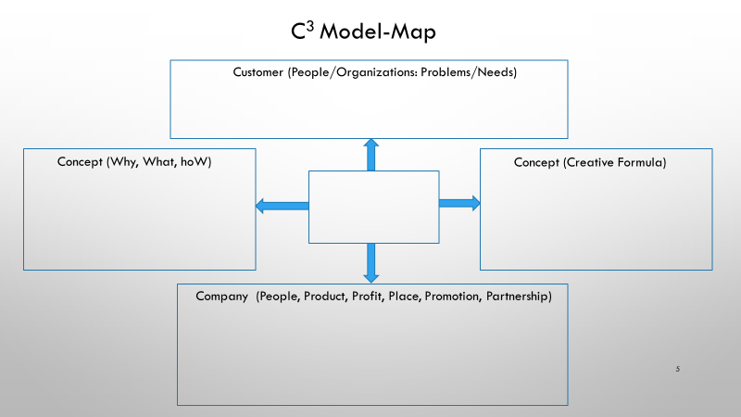

Customer: People who like to take pictures or share their own photos
Problem: Easy to forget details about photos
Need: To record the details about photos and share with others
Why: A sense of nostalgia, only short memories are stored in the brain, to record memories by technology
What: An app to record memories at that moment, that place and share with others
How: Using a lot of functions to make a memoirs and share with others
Time Memories Imager
Camera✖️Gallery✖️Internet
People: Nirvana Rebirth with experts in charge of different professions
Product: An app for saving and editing photos
Profit: Revenues from advertising and subscription
Place: APP stores and website
Promotion: Influencers, social media and trial period
Partnership: Local artists and Corporate with animation production companies
Notes:
Oliver

Slide 16
Marketing information
Mobile photography ---(convenient/popular)
Smartphone penetration ( 91.5% in 2019)
A lack of this type of application:
There are only cameras that record with watermarks
Share button ---(Satisfy the desire to share/
Rely on people sharing photos with the app to make the app more popular)
Among Internet users aged 10 and above, the most common reason cited for using the Internet was "communication/interaction" (98.8% in 2018)
Notes:
Christy

Slide 17
THANK YOU

